Slide 1
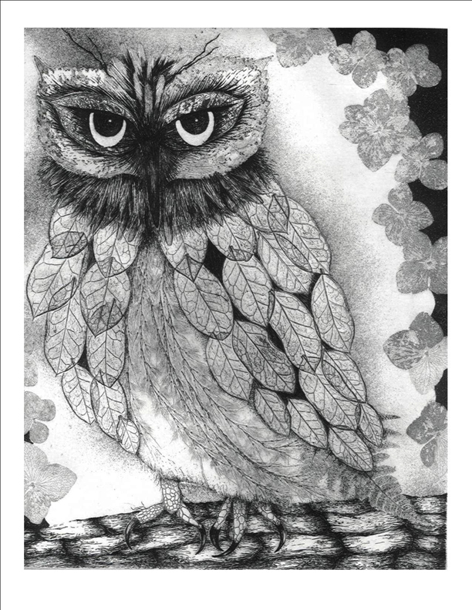
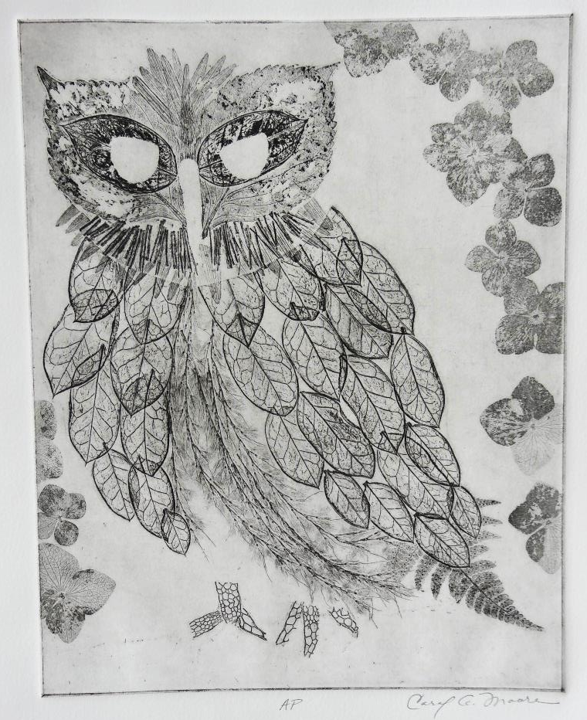
How It Was Made
“True?” By Carol Moore
An artist’s proof (or AP) was made of the print “True?” after the impressions of leaves, pine needles, fern, seaweed, grasses, and hydrangea petal s were made using soft ground.
After layering aquatints and hard ground line I was able to bring my hand to the piece and bring all of the elements together.

