Slide 1
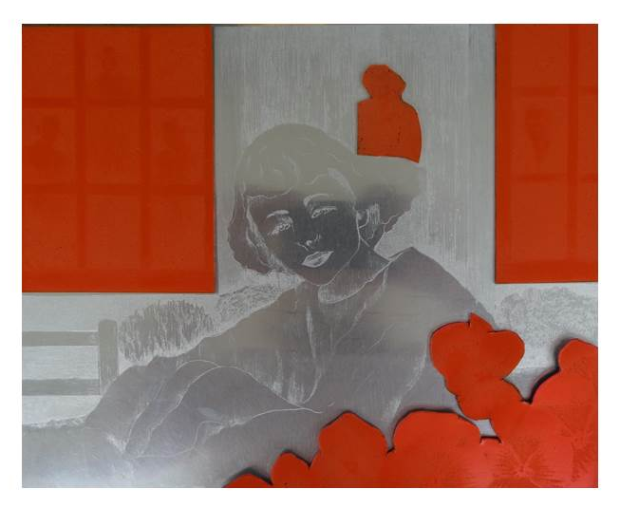
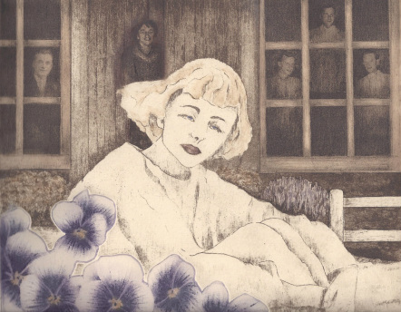
How It Was Made
“Of My Mother” By Carol Moore
My print “Of My Mother” was inspired by my Mom and all the stories she told me about her family. The final print was produced by layering 4 solar plates on a 1 zinc plate. I wanted to incorporate actual pictures of her family, but still draw into them so that they would blend in with the drawing of my Mom (on the zinc plate). Solar plates (the orange plates pictured right) were the perfect medium. A solar plate is a steel plate that has been coated with a UV light sensitive coating. It can be worked on directly with a non-water based substance or images printed on a transparency can be layered on the plate. The plate is then exposed to sunlight or exposed in a UV light box. Afterwards, the plate is processed with warm water and leaves behind an incised image that can be printed. This process allows for digital images to be printed and can be combined with other Intaglio techniques.

