Slide 1
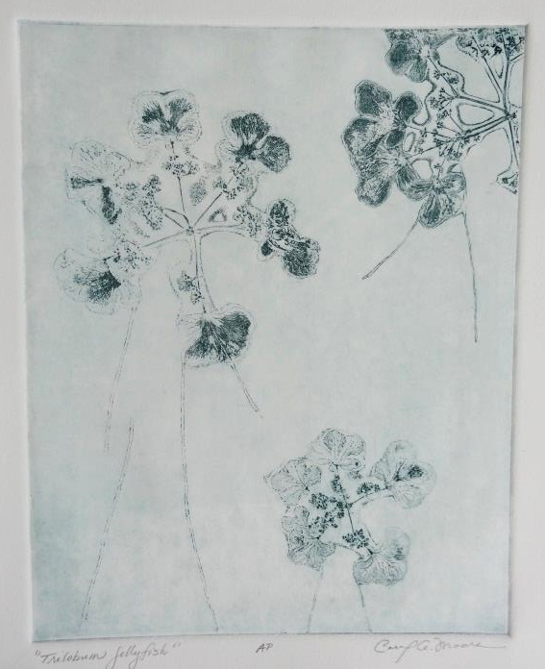
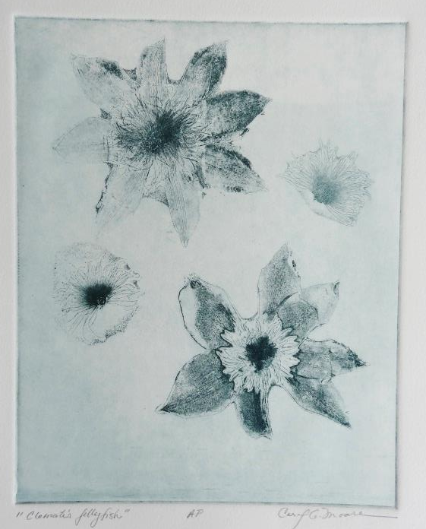
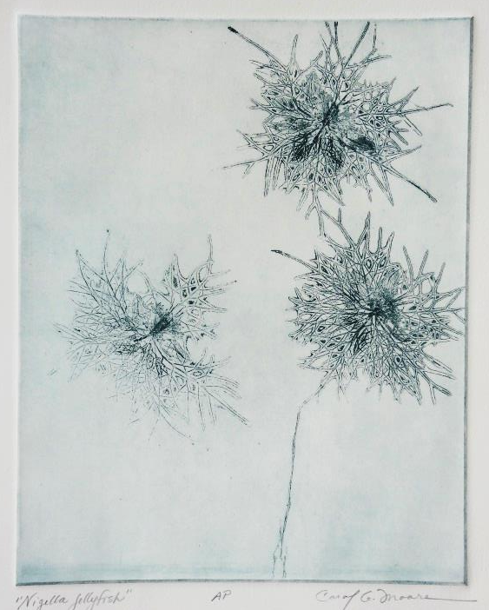
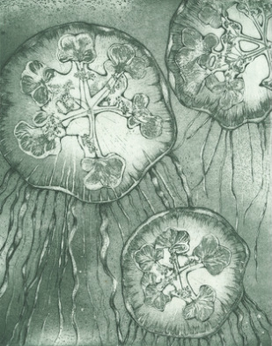
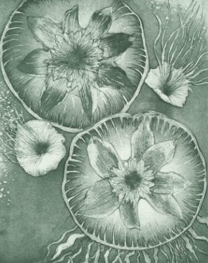
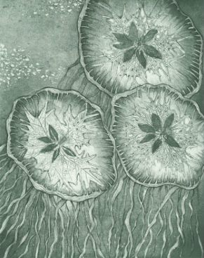
How It Was Made
Suite of Three “Blooming Jellyfish” By Carol Moore
An artist’s proof (or AP) was made of the prints “Trilobum Jellyfish,” Clematis Jellyfish,” and “Nigella Jellyfish” after impressions of the actual flowers were made on the plate using soft ground. Although beautiful and interesting I wanted to explore the repeating patterns found in nature and turn them into Jellyfish.
All three plates were worked simultaneously to ensure that all of the tones were the same. I wanted all of the jellyfish to look as if they could exist in the same waters. After layering aquatints and hard ground line I was able to bring my hand to the piece and bring all of the elements together.

